Slide 1

Principal Component Analysis (PCA)

Slide 2
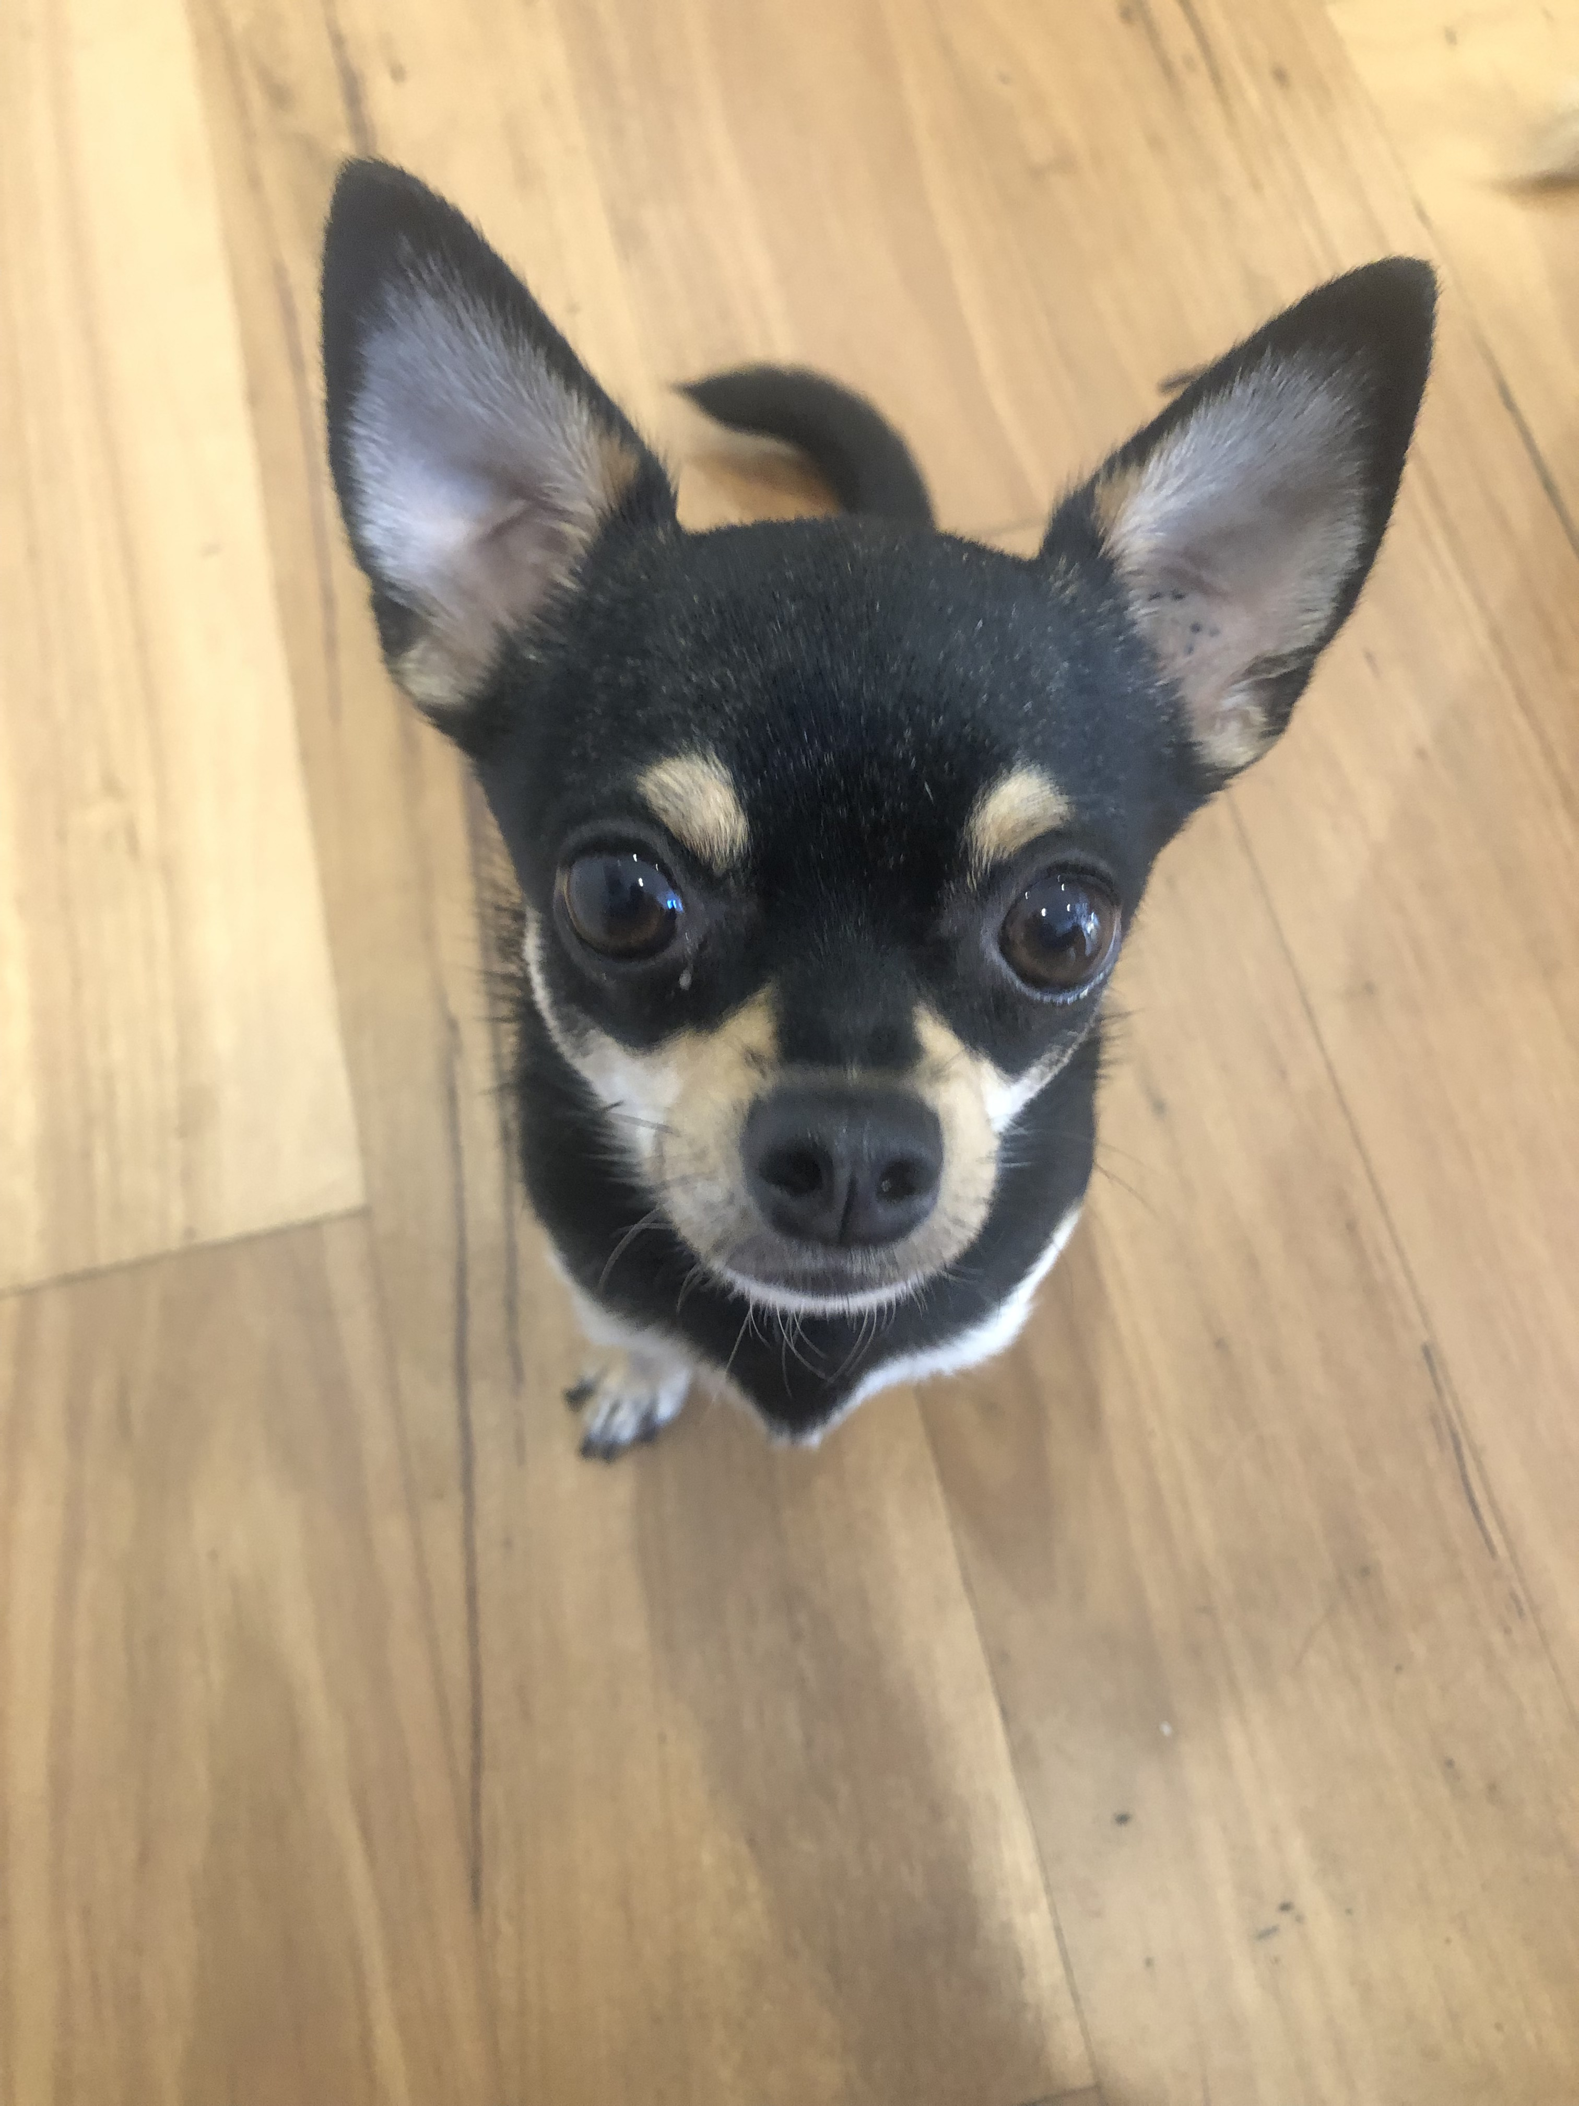
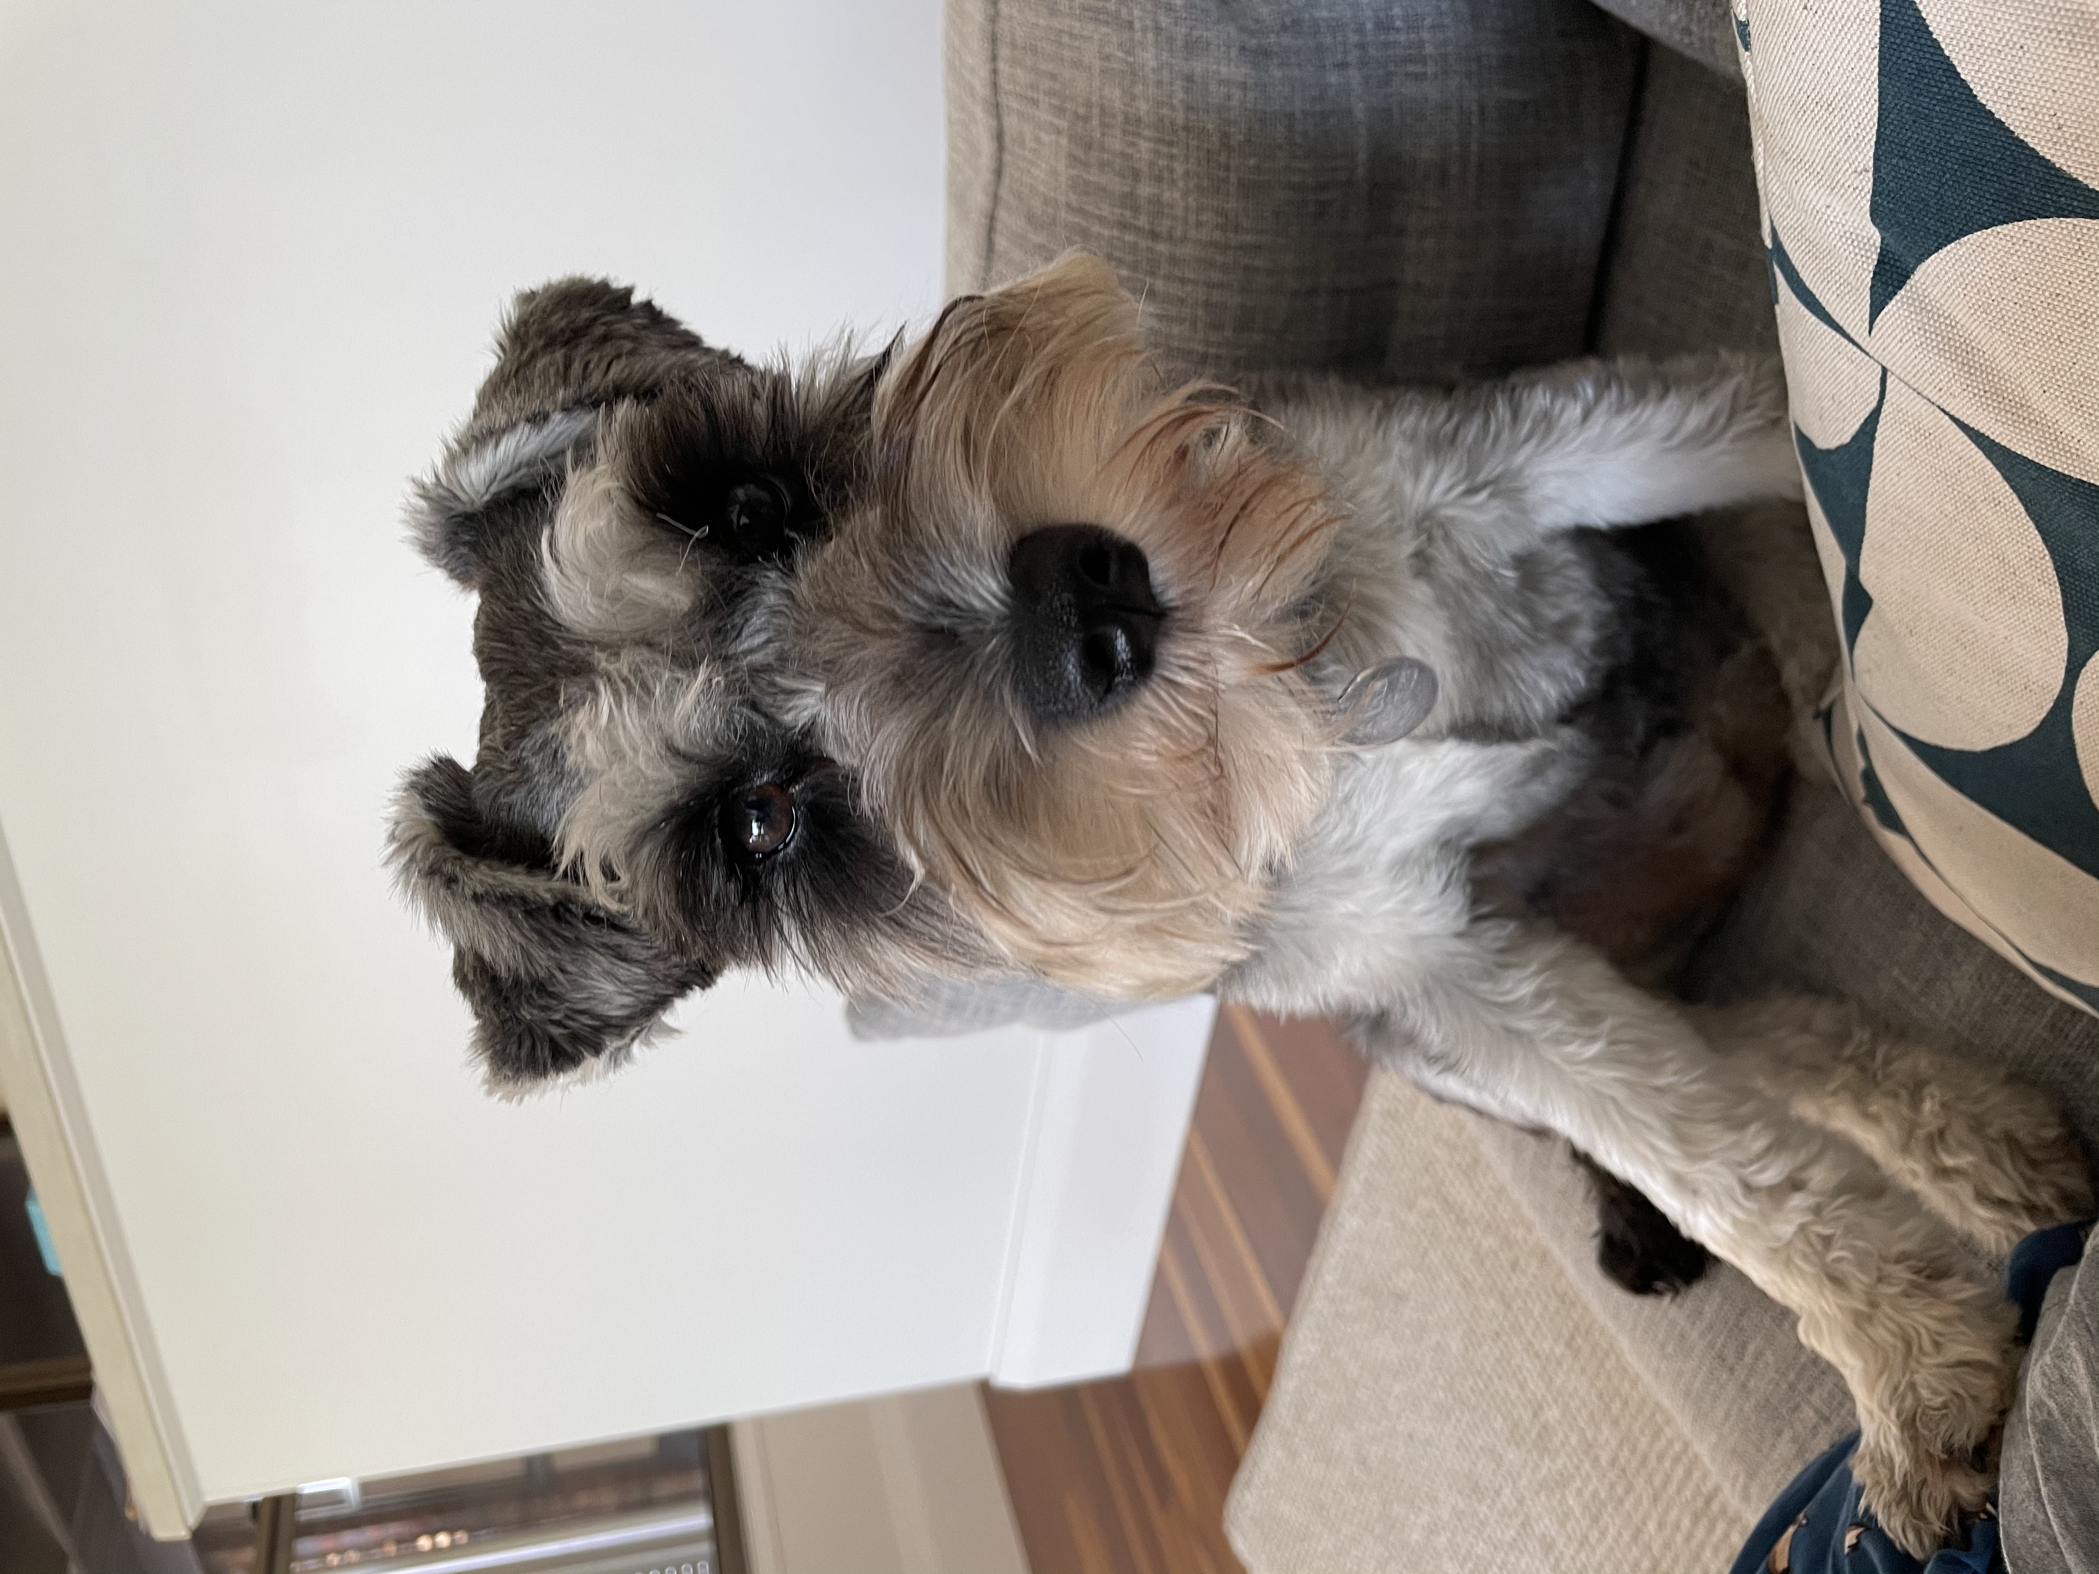
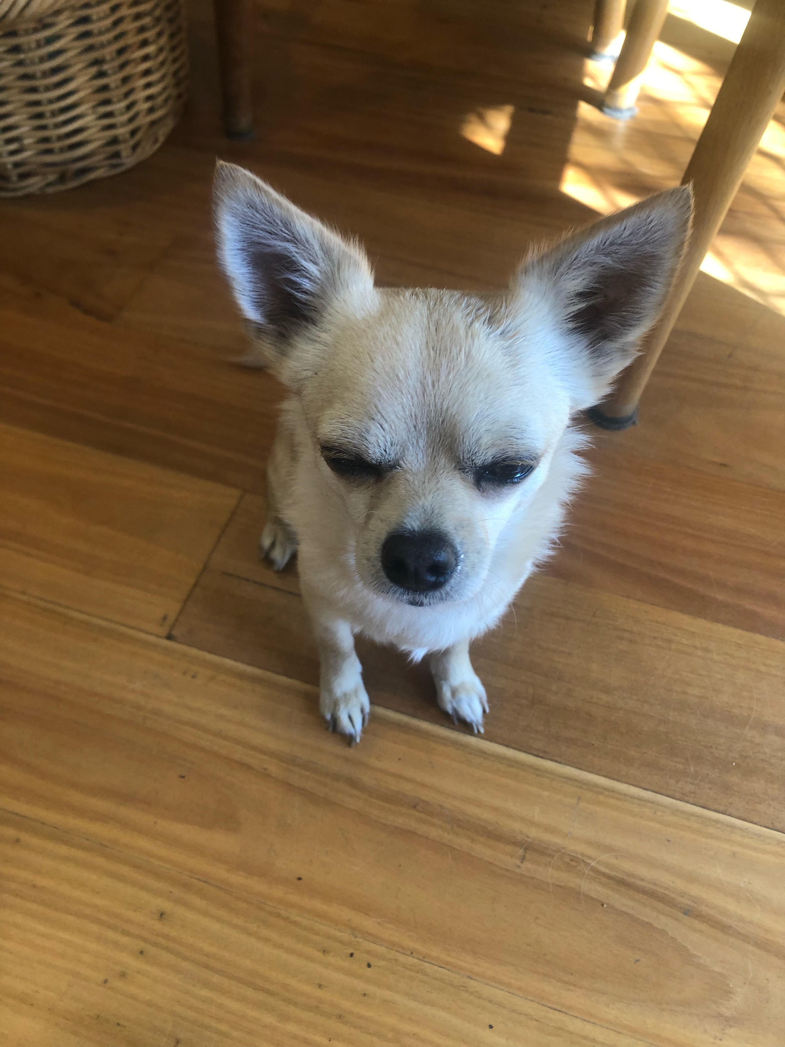
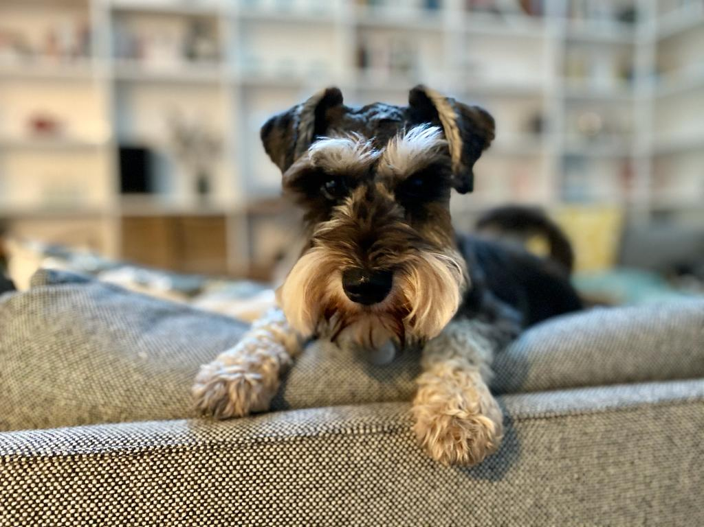
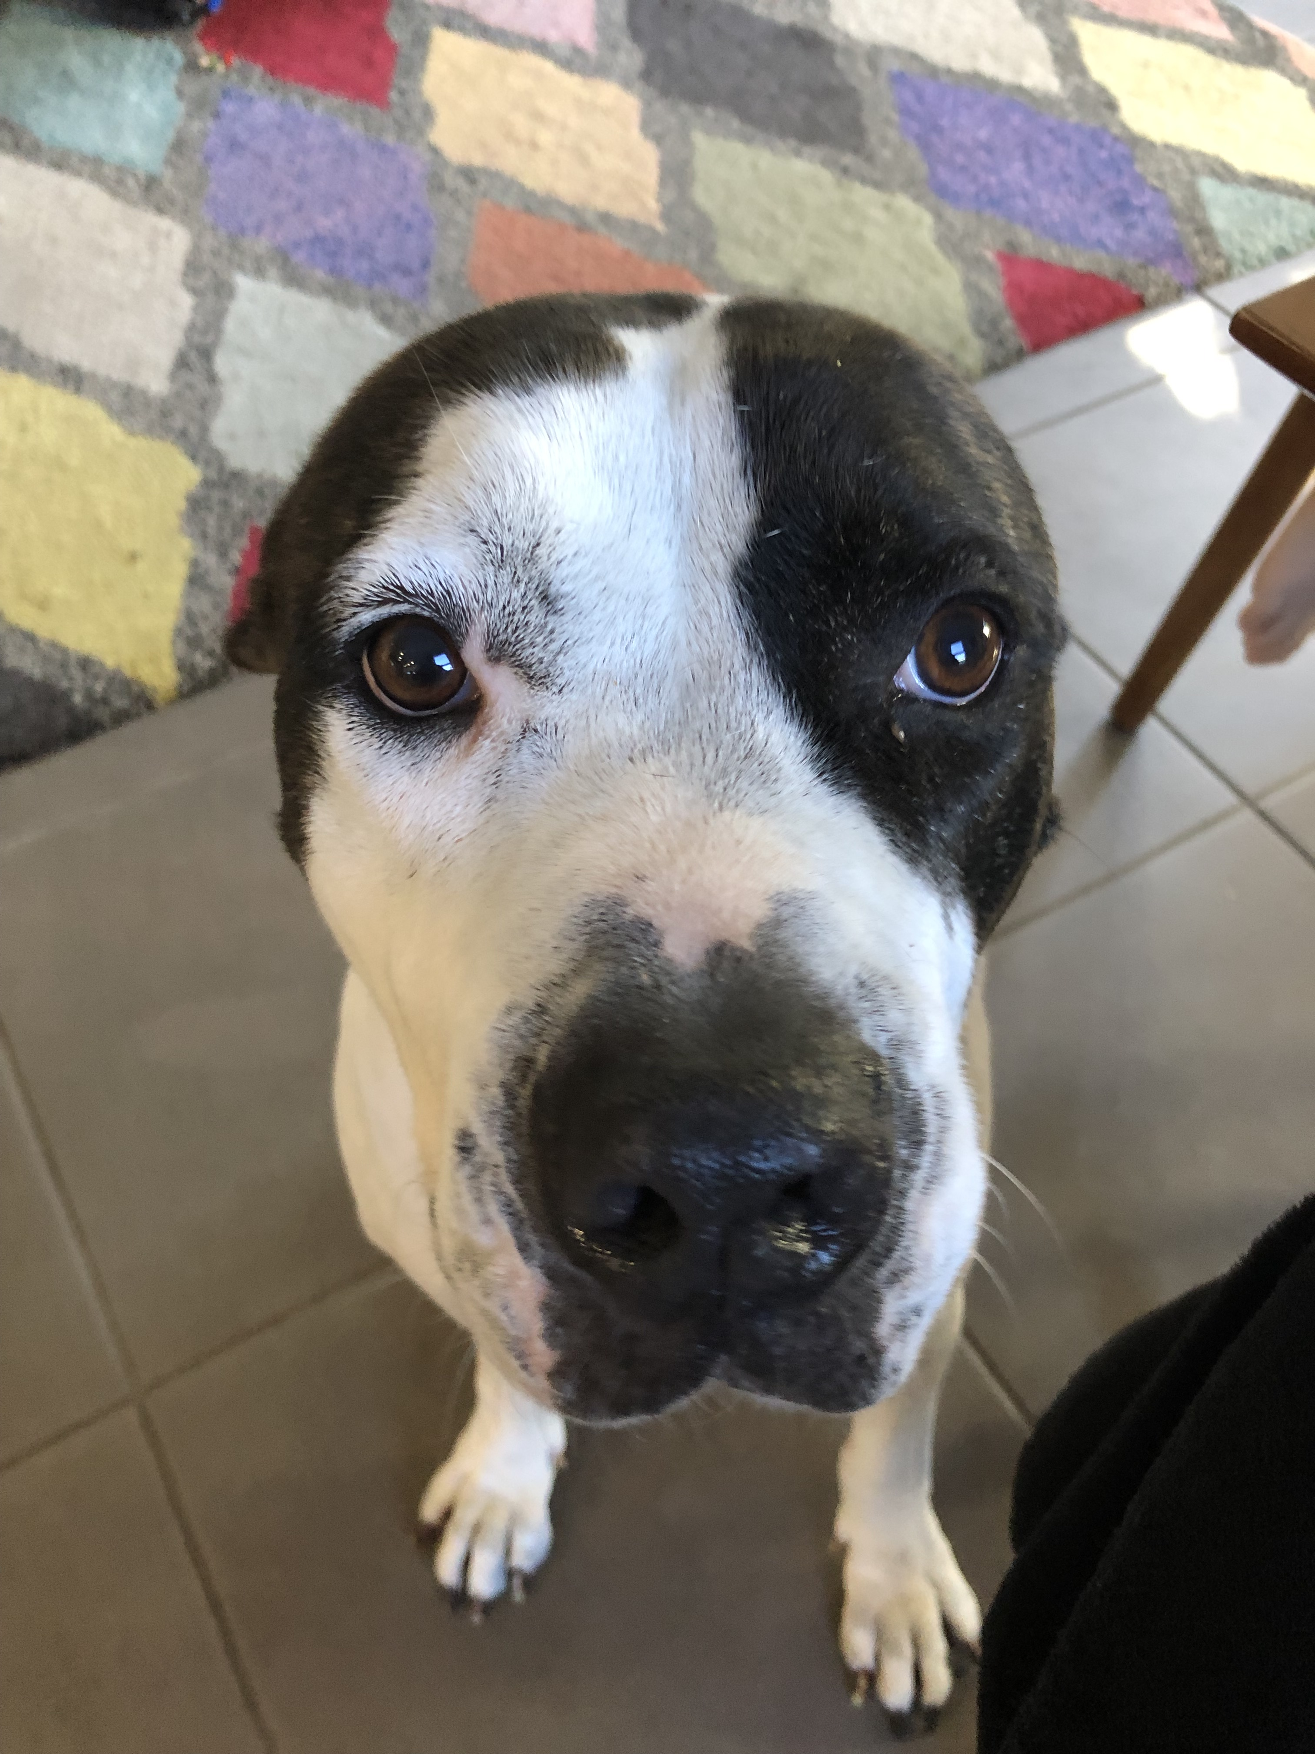
PCA: A Dog Traits Example

Slide 3
We measured 6 traits on each of 200 dogs
Mass (kg)
Beard length (cm)
Yappiness (human cortisol level)
Rat Face Index (RFI; unitless)
Objectively cute (human oxytocin level)
Dog attacks per year (a rate)

Slide 4
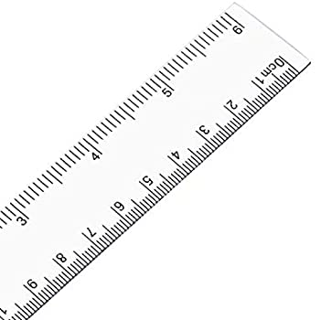


Slide 5
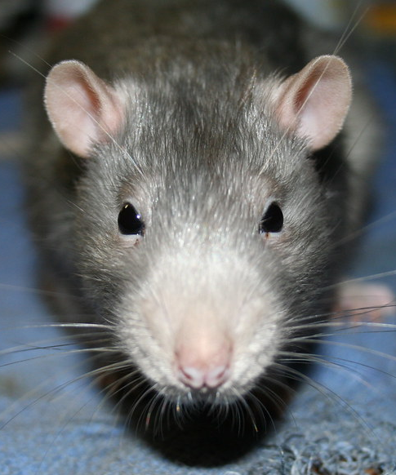
Rat Face Index (RFI; unitless)
LOW
HIGH
Universal reference rat face

Slide 6
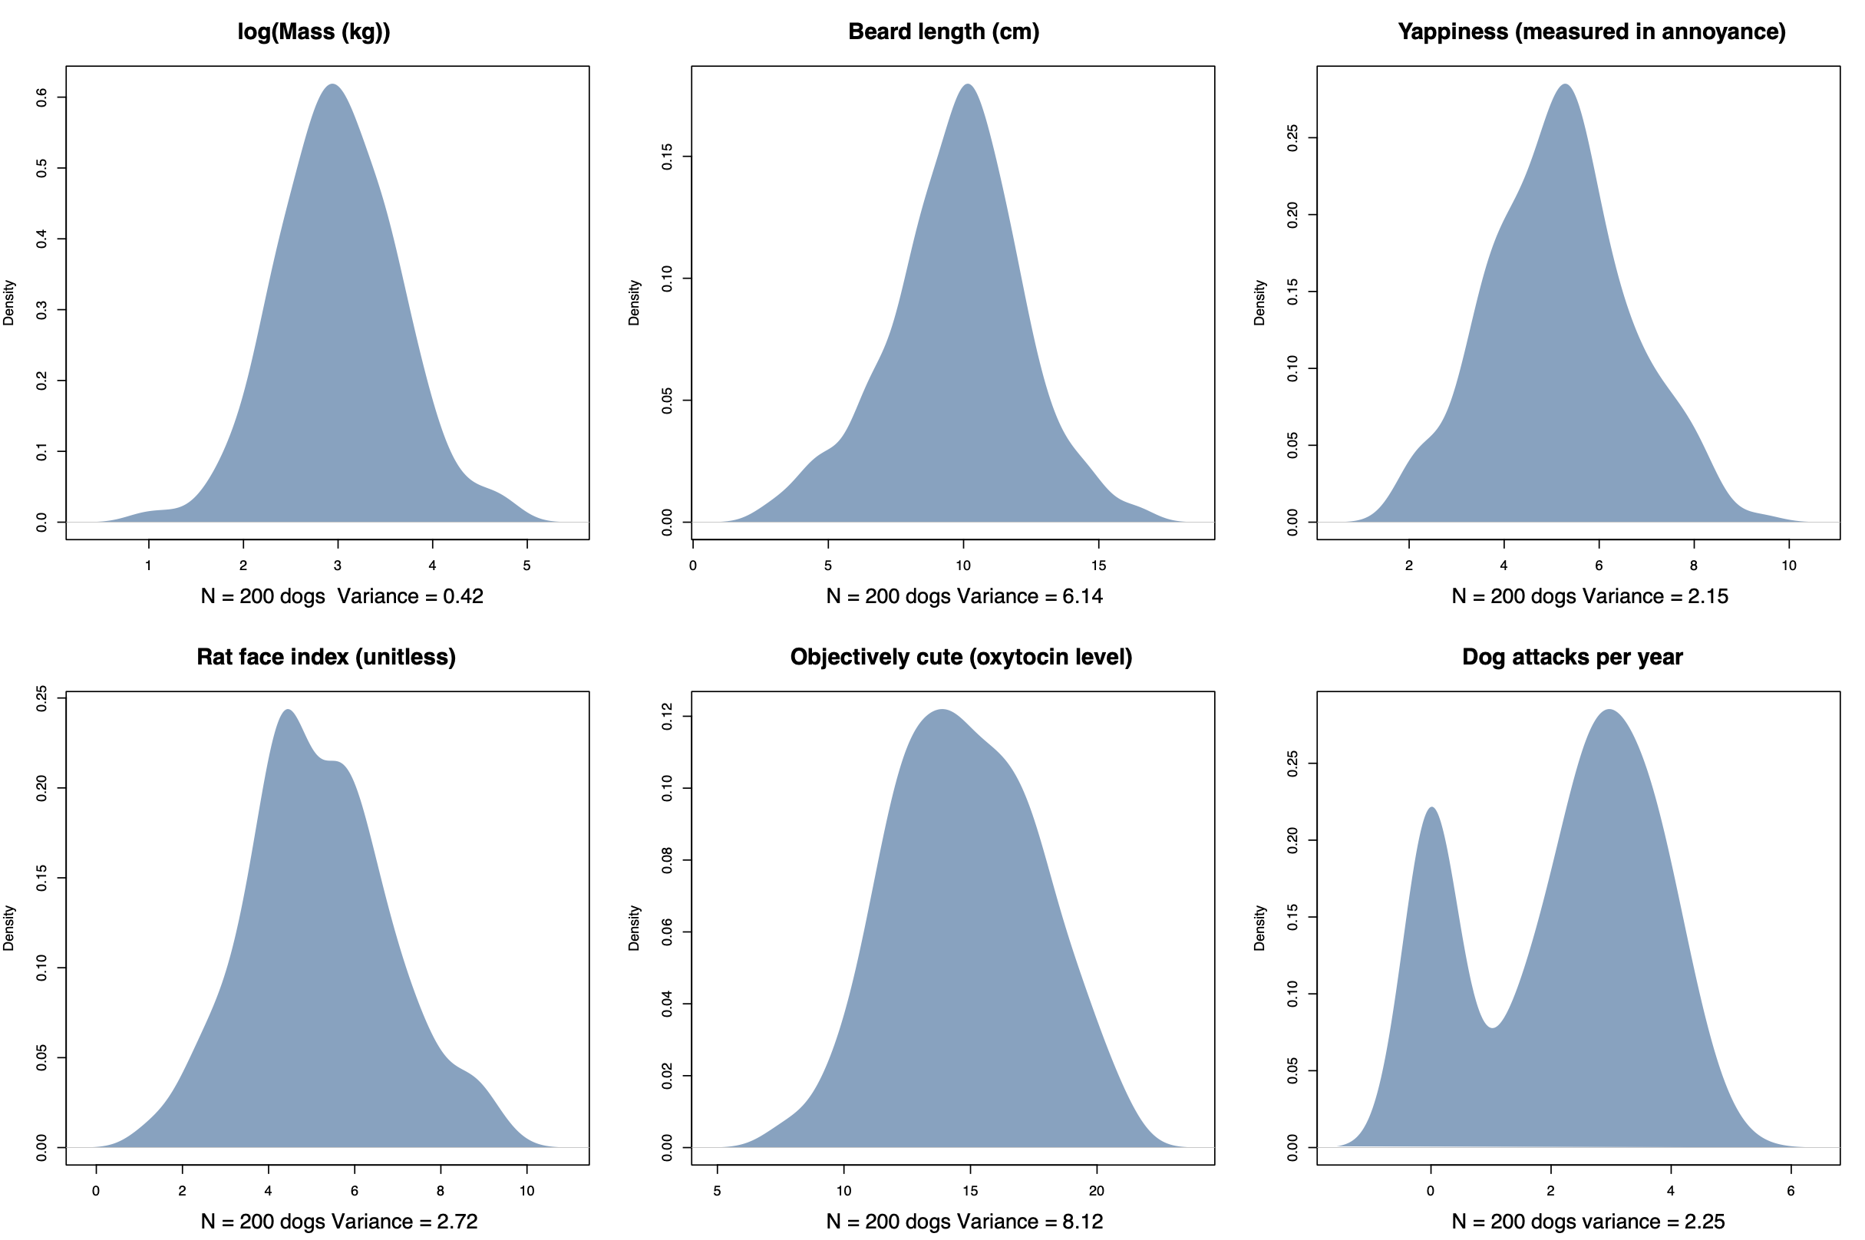

Slide 7
Let’s start with just 2 variables

Slide 9
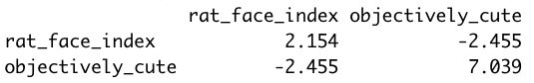
Covariance matrix

Slide 10
Covariance matrix

Slide 11
Covariance matrix

Slide 12
Covariance matrix

Slide 13
Standardised variables

Slide 14
Correlation matrix
1.000
-0.630
-0.630
1.000

Slide 15
Correlation matrix
1.000
-0.630
-0.630
1.000
We can actually explain a lot of this pattern with just one axis!!!
(Think about it - if axes are perfectly correlated they are pretty much the same thing)

Slide 16
Correlation matrix
1.000
-0.630
-0.630
1.000
New axis
We can actually explain a lot of this pattern with just one axis!!!
(Think about it - if two variables are perfectly correlated they are pretty much the same thing)

Slide 17
Principal component analysis (PCA)
Rotates the original axes to a new set of uncorrelated axes
Converts correlated data into uncorrelated data!
First step is "eigenanalysis” of the correlation matrix

Slide 18
Eigenanalysis
This is just matrix algebra (not covered here)
Generates two outputs:
Eigenvalues: the variances of each of our new variables
Think of these as the length of each new variable
Eigenvectors: our new axes (called "principal components" or PCs)
Think of these as the direction of the new variables

Slide 19
What the heck are eigenvectors?
New variable 1 = PC1_LOADING1 * old_variable1_{i} + PC1_LOADING2 * old_variable2_{i}

Slide 20
What the heck are eigenvectors?
New variable 1 = PC1_LOADING1 * old_variable1_{i} + PC1_LOADING2 * old_variable2_{i}
PC1

Slide 21
What the heck are eigenvectors?
New variable 1 = PC1_LOADING1 * old_variable1_{i} + PC1_LOADING2 * old_variable2_{i}
LOADINGS define how the old axes get adjusted and combined to become our new PCs
Combined, these loadings are the first eigenvector

Slide 22
What the heck are eigenvectors?
New variable 2 = PC2_LOADING1 * old_variable1_{i} + PC2_LOADING2 * old_variable2_{i}
PC2
PC2 is PERPENDICULAR to PC1!!!

Slide 23
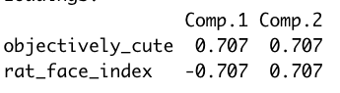
Our simple dog PCA
PC1 scores = -0.707 * rat_face_index_{i} + 0.707 * objectively_cute_{i}
PC2 scores = 0.707 * rat_face_index_{i} + 0.707 * objectively_cute_{i}

Slide 26
Low cuteness
High rat face index
High cuteness
Low rat face index

Slide 28
(Left over) high cuteness
(Left over) high rat face index
(Left over) low cuteness
(Left over) low rat face index

Slide 29
Eigenvalue 1 = 1.63
Eigenvalue 2 = 0.37
Total variance = 2

Slide 30
Eigenvalue 1 = 1.63
Eigenvalue 2 = 0.37
Total variance = 2
1.000
-0.630
-0.630
1.000

Slide 31
PC1 explains 81% of the total variance in both original variables!!!
PC2 explains the remaining 19%
Eigenvalue 1 = 1.63
Eigenvalue 2 = 0.37
Total variance = 2

Slide 32
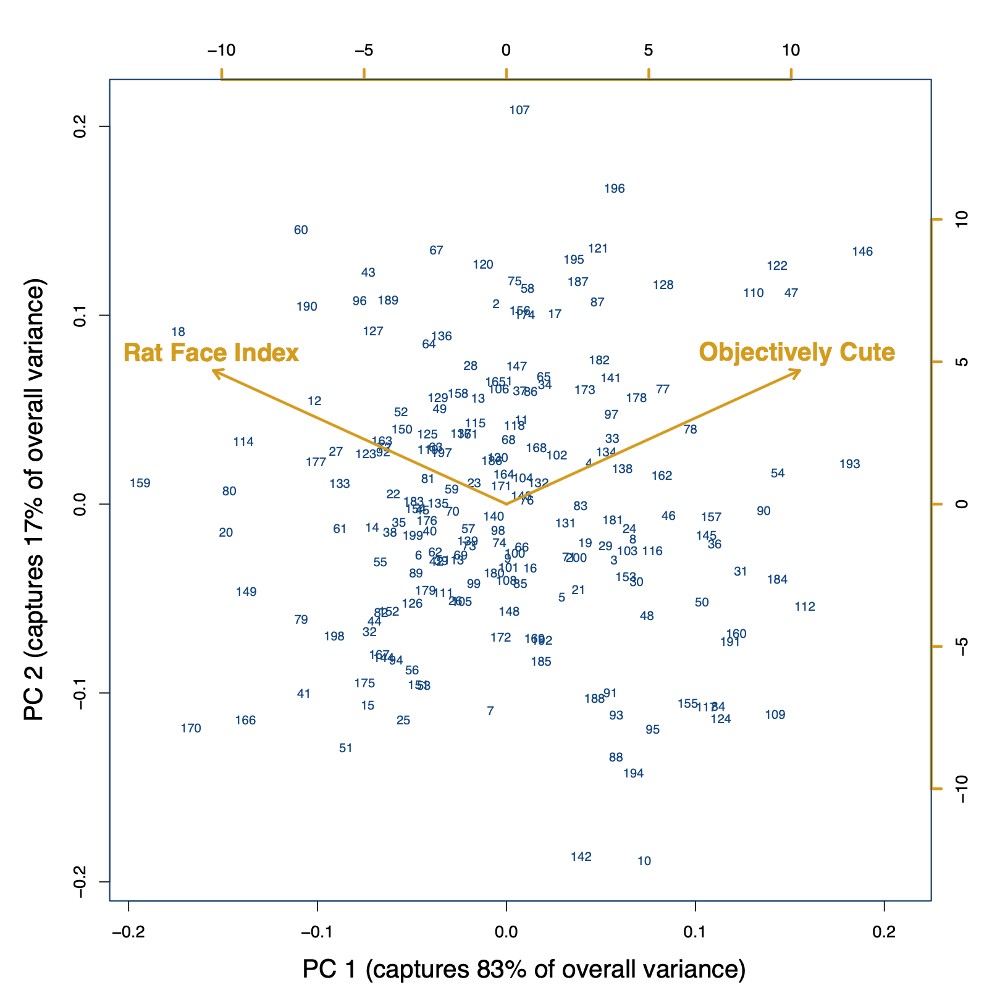
PC2 (explains the remaining 19%)
Low cuteness
High rat face index
High cuteness
Low rat face index
PC1 (explains 81% of the total variance in both original variables)

Slide 33
What about the rest of the dog traits?

Slide 34
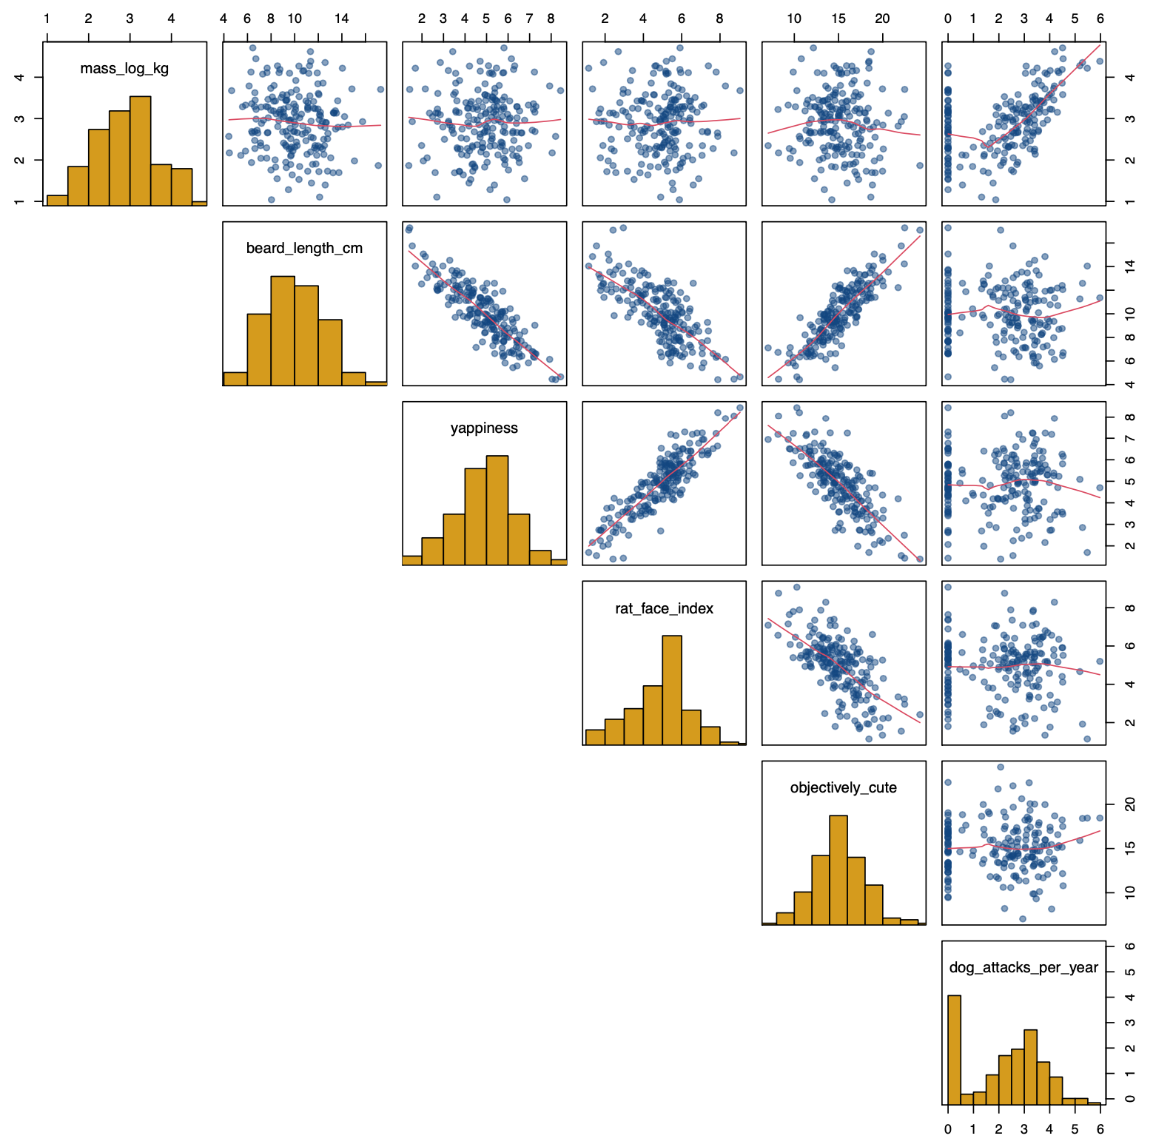

Slide 35
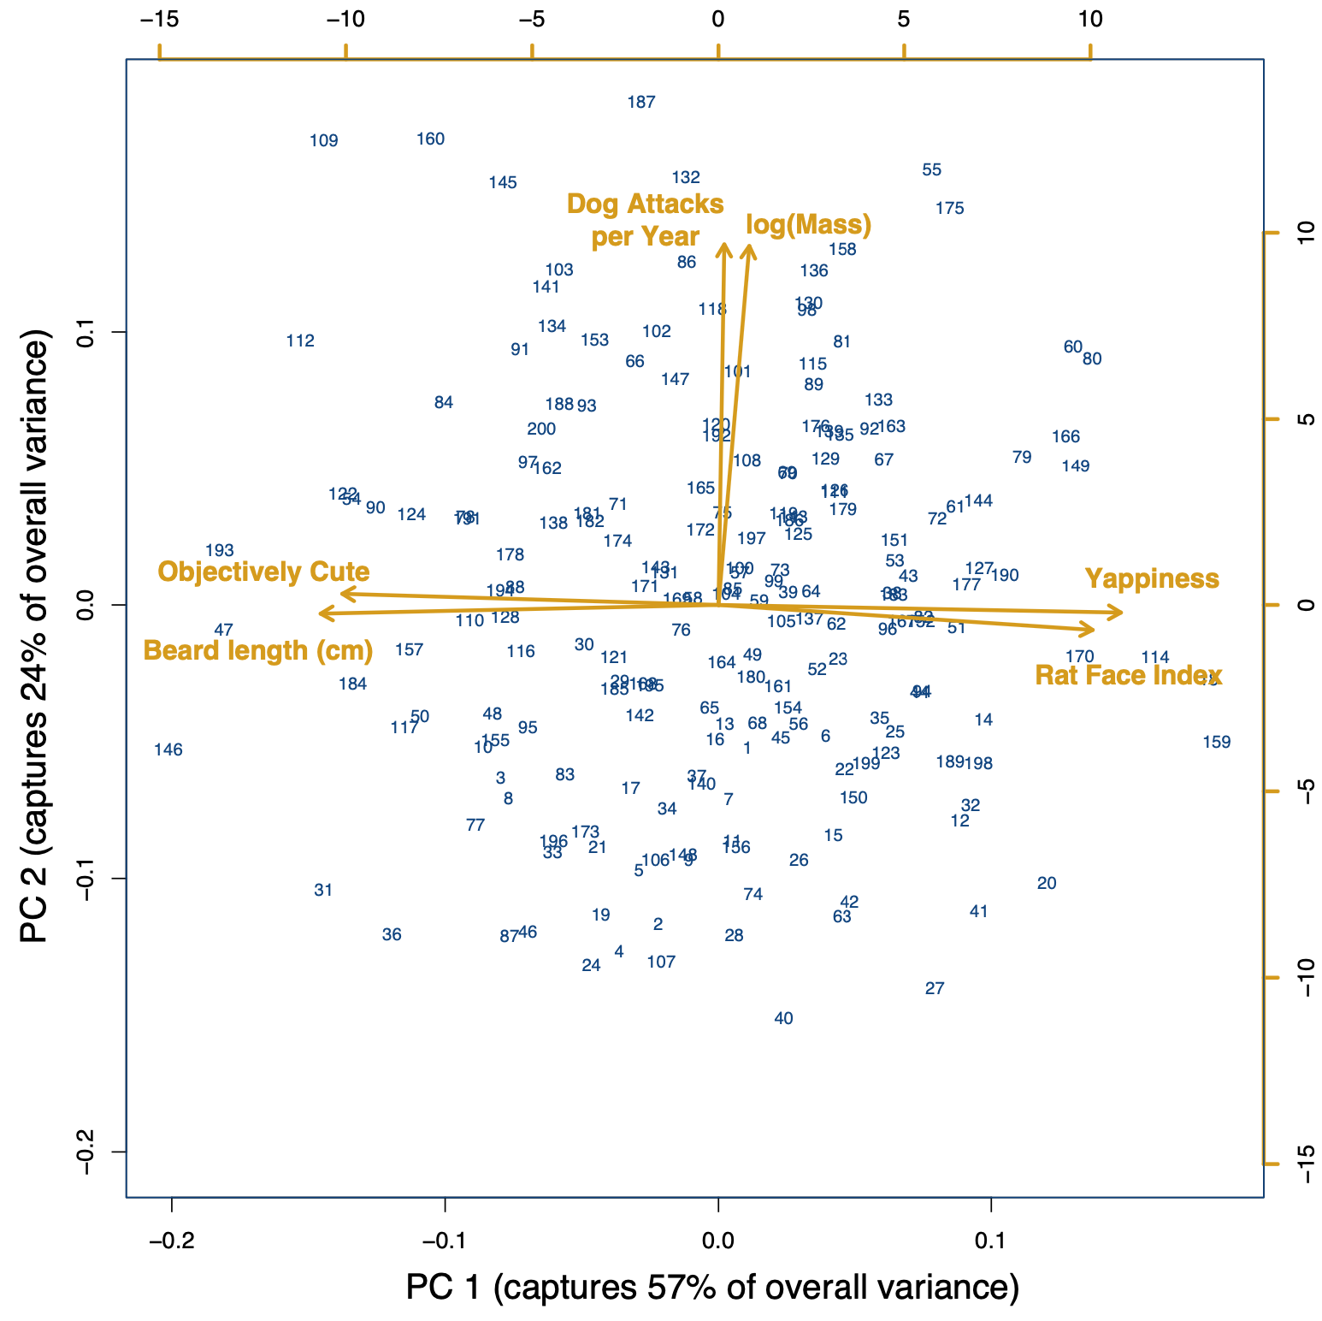
High cuteness
Long beards
Not yappy
Low RFI
Yappy little shit
Pretty much a rat
Not cute
Short beard

Slide 36
LOADINGS
PC 1 PC2
Log(Mass) 0 0.704
Beard length (cm) -0.512 0
Yappiness 0.519 0
Rat Face Index 0.482 0
Objectively cute -0.484 0
Dog attacks / year 0 0.707
High cuteness
Long beards
Not yappy
Low RFI
Yappy little shit
Pretty much a rat
Not cute
Short beard

Slide 37
Large dogs that eat yappy little rat-dogs
High cuteness
Long beards
Not yappy
Low RFI
Yappy little shit
Pretty much a rat
Not cute
Short beard

